Slide 1
AGENT INSURANCE RENEWAL
Team Members:
1.AJAY KUMAR S
2.DEEPAK KUMAR D
3.GUNA S
Industrial Guide:
Mr. BALANIRMAL KUMAR
Faculty Guide:
Mrs. VINOLINA R
Department of CSE, KGiSL Institute of Technology, Coimbatore

Slide 2
Abstract
It is important to have an insurance policy as it provides financial protection against unfortunate accidents that may cause damages to the insured vehicle, damages to the third party properties and bodily injury to the rider, pillion or people.
Having an insurance policy reduces the financial burden in the case of loss or damages arising from an accident caused to or by your insured vehicle.
The renewal date of your insurance policy is based on the date on which your policy was took. Using this app, the agents can notify the clients through
E-mail or SMS regarding the unpaid (pending) amount and acknowledge them
regarding the renewal process.
The payment will be done by the client with the help of the agent to the
Insurance company.
The agent can also check the status by using their policy number.
Department of CSE, KGiSL Institute of Technology, Coimbatore

Slide 3
Existing system
The existing system of insurance renewal mostly are on webpages and apps.
All the apps are third party company apps.
These apps acts as a broker or an intermediate in insurance renewal.
There is no support for E-mail or SMS notification.
The existing application does not include insurance renewal calculation based on the current GST prices.
Department of CSE, KGiSL Institute of Technology, Coimbatore

Slide 4
Proposed System
The proposed system includes the renewal of insurance policy of vehicles only.
Advantages Over the existing system
The system is to be built with KOTLIN, and Firebase for database.
It calculates the renewal amount with respect to Government updates.
Provide SMS and Email notification based on the expiry of the renewal date.
Generate a renewal notice with Included taxes, no claim bonus and other commissions.
Payment will be done to the Insurance company with the help of the agent.
Department of CSE, KGiSL Institute of Technology, Coimbatore

Slide 5
Literature Review
Drawbacks of existing methods
Not designed for specific agency.
Does not prioritize alerts based on Expiry date.
References
POLICY BAZAAR : www.policybazaar.com
COVER FOX : www.coverfox.com
Department of CSE, KGiSL Institute of Technology, Coimbatore

Slide 6
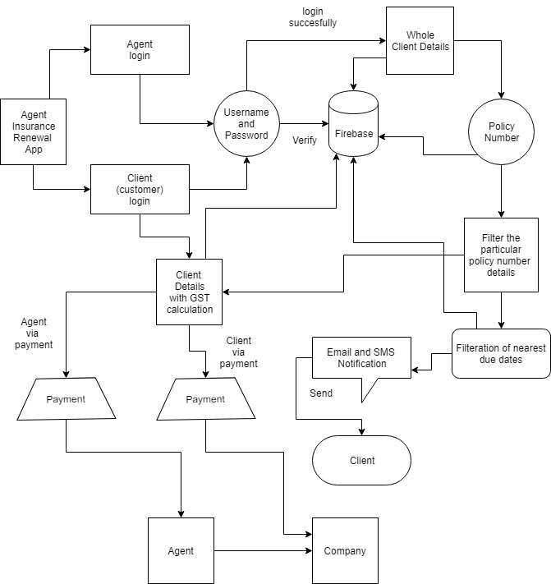
Architectural Design-DFD
Department of CSE, KGiSL Institute of Technology, Coimbatore

Slide 7
Module Split-up
MODULE 1:
Provide Firebase Authentication for Agents and to provide a Firebase Database to display all users under the agent.
MODULE 2:
Provide an Email/SMS alert feature for the agent.
MODULE 3:
Generate a Renewal notice based on the taxes, no claim bonus and the agent commission.
MODULE 4:
Payment to the Insurance company with the agent as the mediator.
Department of CSE, KGiSL Institute of Technology, Coimbatore

Slide 8
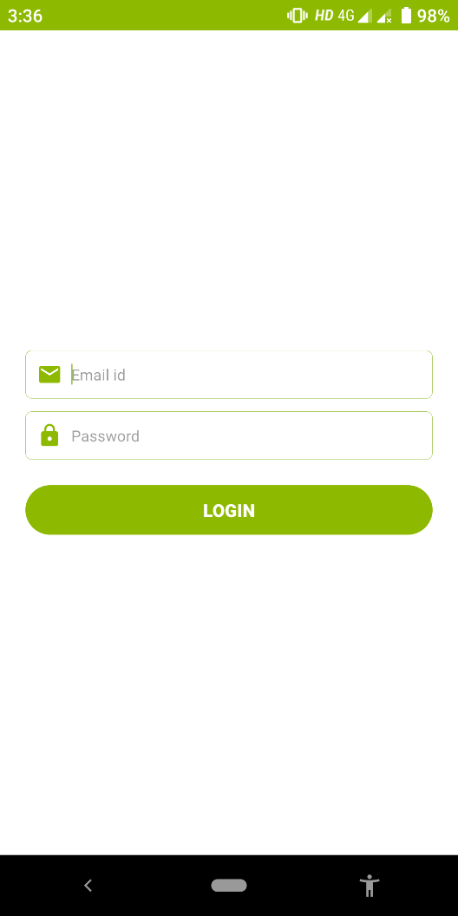
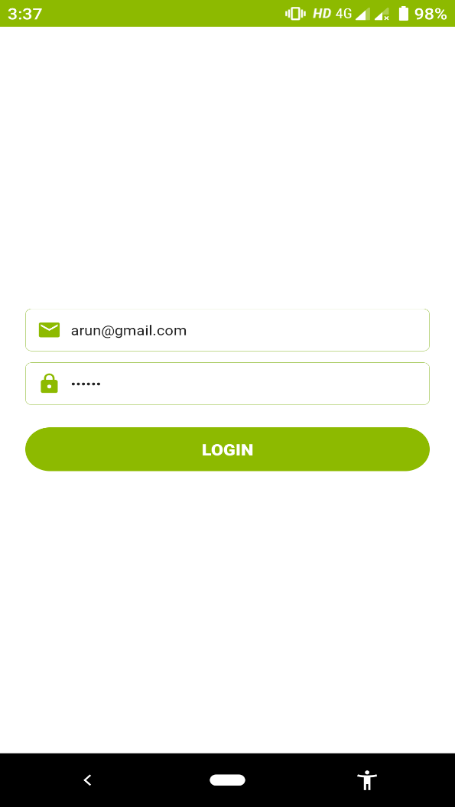
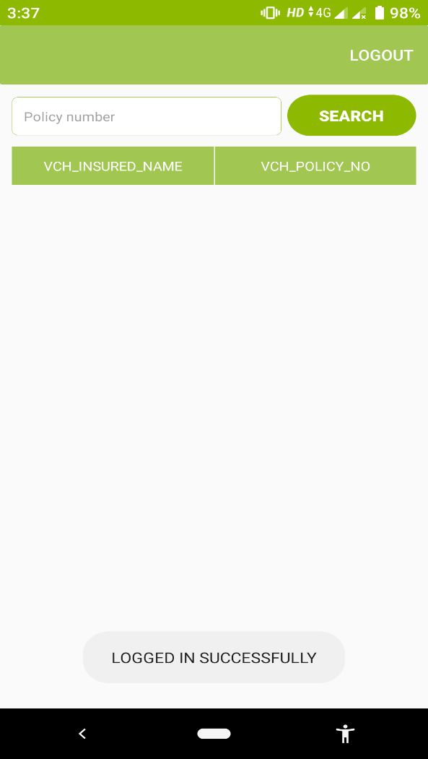
Snapshots
Department of CSE, KGiSL Institute of Technology, Coimbatore

Slide 9
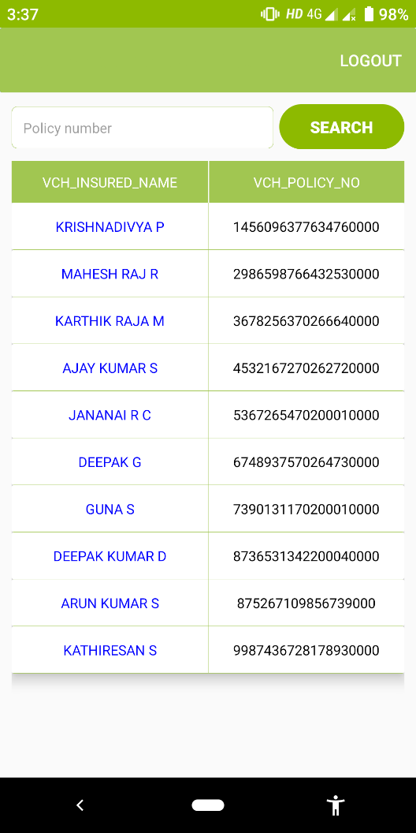
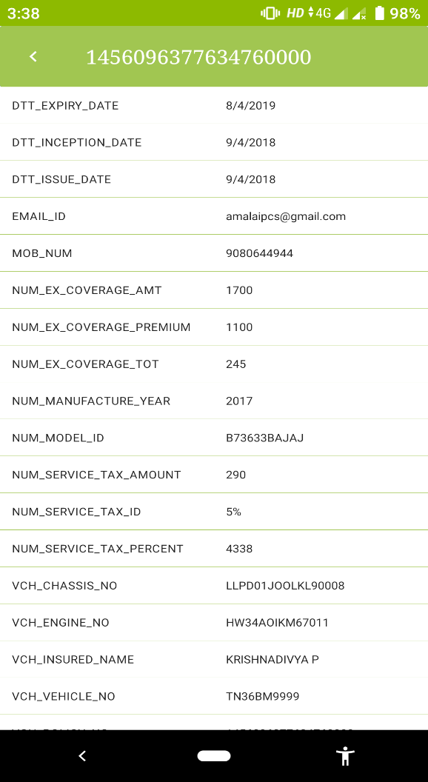
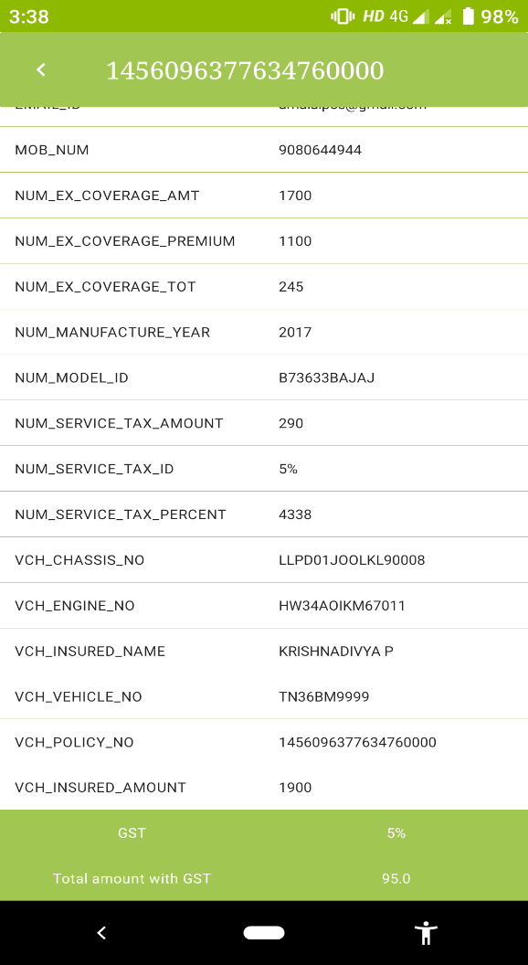
Snapshots

Slide 10
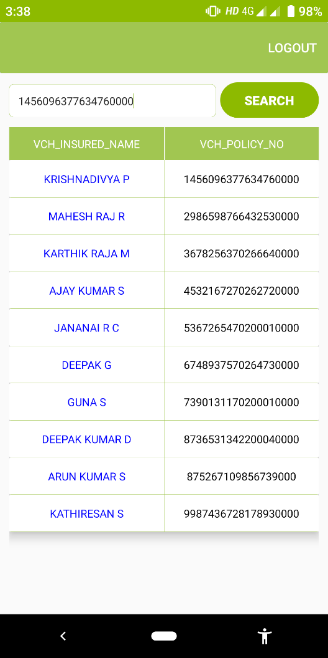
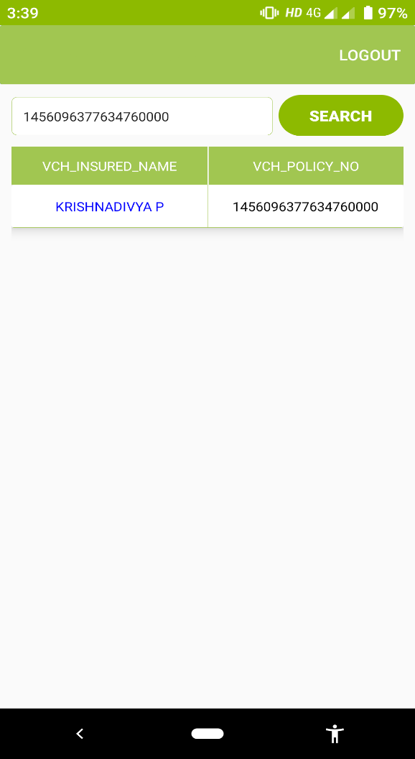
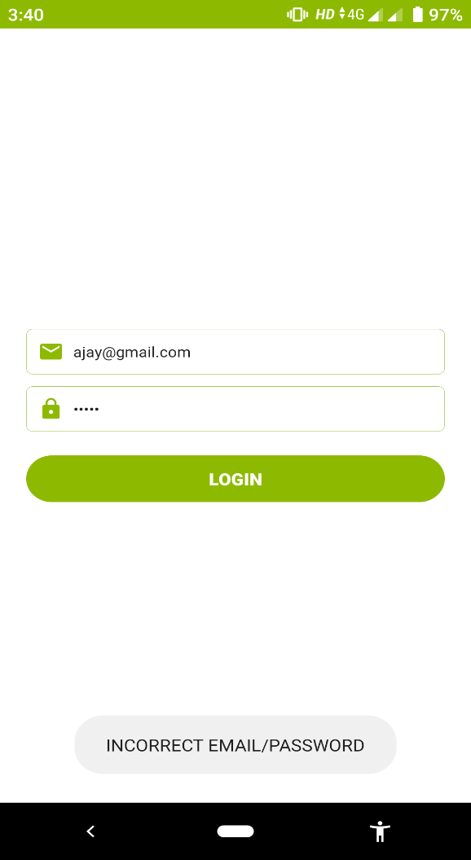
Snapshots

Slide 11
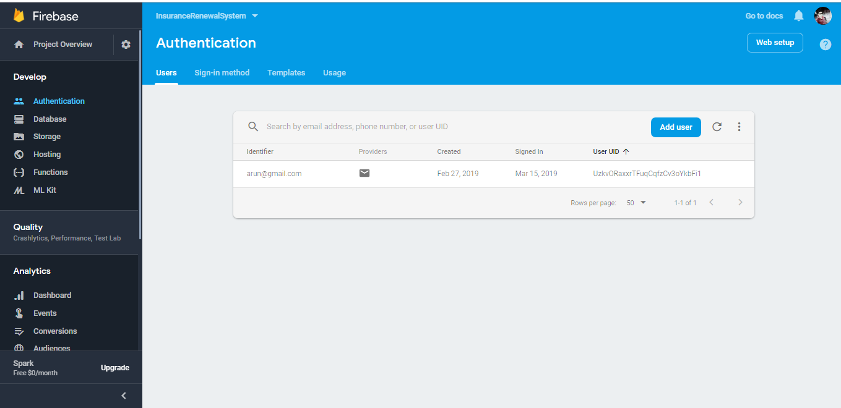
Snapshots

Slide 12
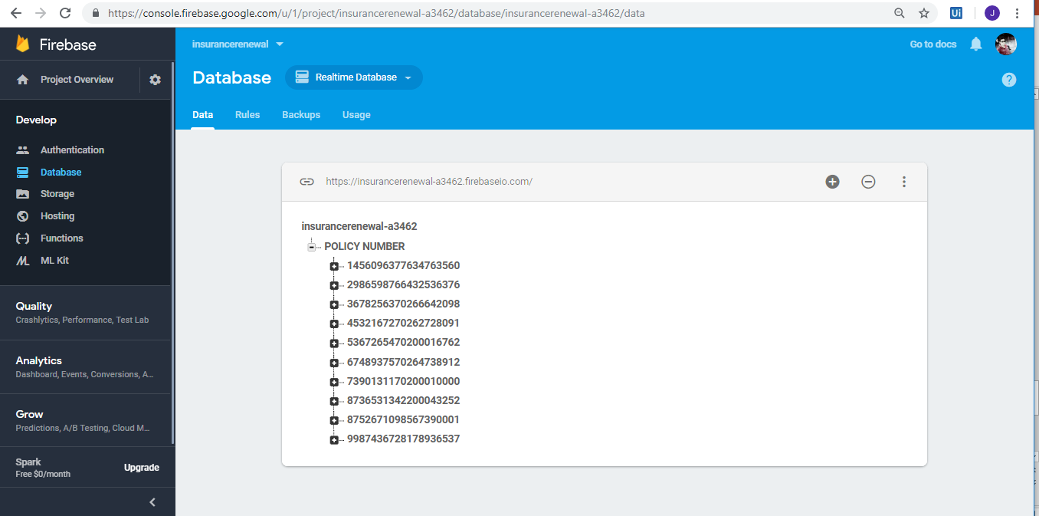
Snapshots

Slide 13
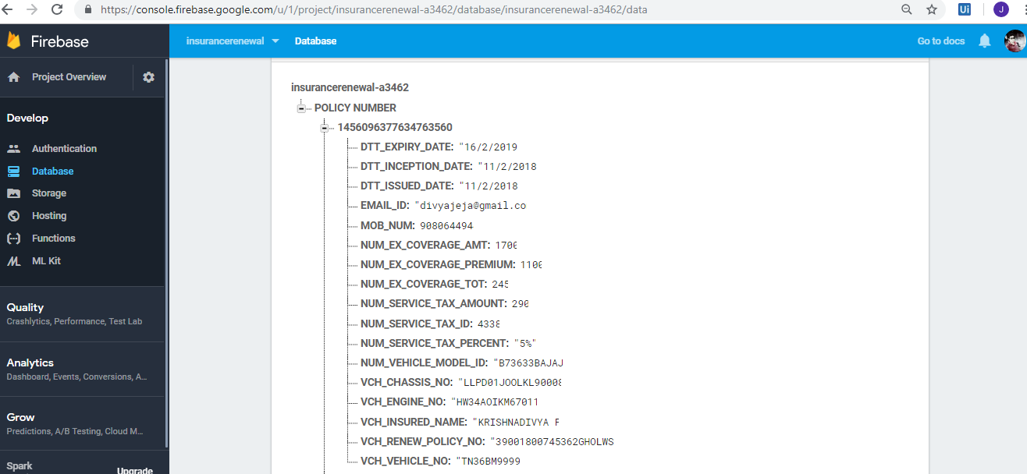
Snapshots

Slide 14
THANK YOU
Department of CSE, KGiSL Institute of Technology, Coimbatore

